Slide 1
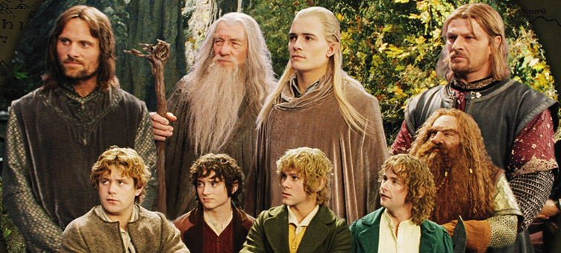

The Fellowship of the Data
Source:myblogs.pw
Sev Leonard
sev@thedatascout.com
gizm0_0

Slide 2
Greetings
Some bits about me

Slide 3
Class info
Tutorial content & setup instructions: https://github.com/gizm00/pycon2016
All http requests are handled by the pycon2016_lamp Docker container

Slide 4
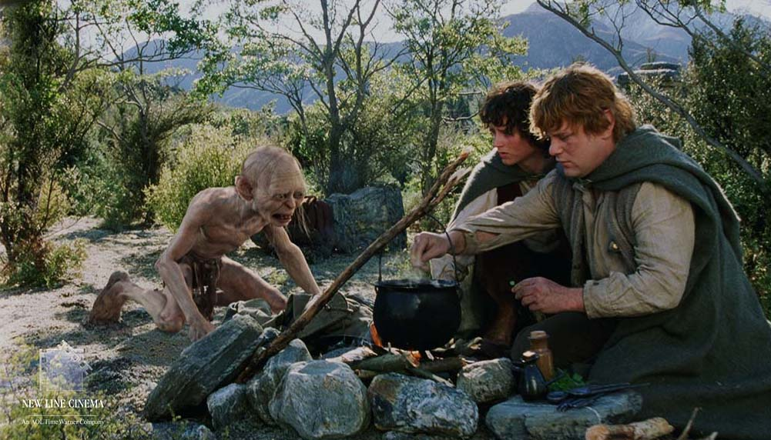
About the tutorial
Gather campground information from multiple sources to create The One Camping Database, presently hosted at www.campnear.me
Source:artistthinks.wordpress.com

Slide 5
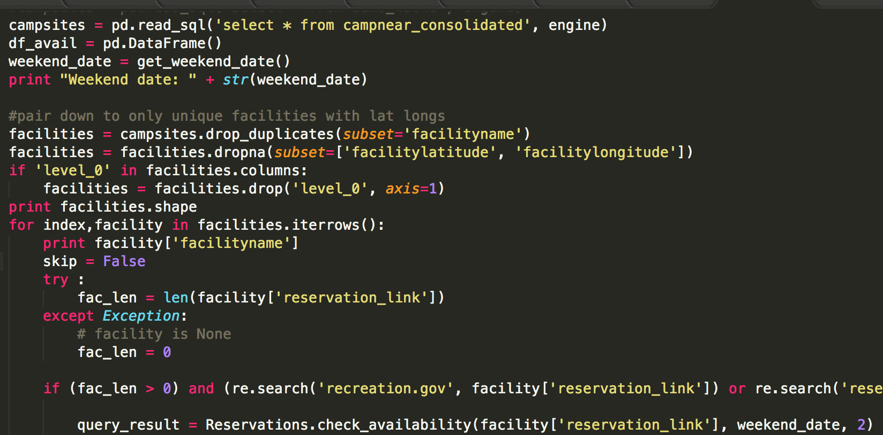

Slide 6
Connect to source
Connect to source
Extract data
Extract data
Clean / format data
Clean / format data
Merge
Store
Analyze
Merge
Store
Analyze

Slide 7
RIDB API
NF websites
Connect to source
Connect to source
Extract data
Merge
Extract data
Reservations
Connect
Store
Clean / format data
Extract
Store
Merge
Merge
Analyze

Slide 8
How will objects help?
Encapsulate properties that are likely to change – API parameters, scraping code, etc
Build on abstractions to further distance from implementation details
Create testable, maintainable structures
Quick incorporation of new sources and views

Slide 9
Look across
Connect to source
Connect to source
Extract data
Extract data
Clean / format data
Clean / format data
Merge
Store
Analyze
Merge
Store
Analyze

Slide 10
About the data
Data sources include the Recreational Information Database (RIDB), US Forest Service (USFS) websites, and recreation.gov
RIDB API – campground name, lat/long
USFS – scrape additional campground information
recreation.gov - scrape reservation availability by form navigation

Slide 11
Agenda
Section 1: Web data best practices
Section 2: Gathering data from the web
15min Break
Lab 2: RIDB API, Scraping USNF pages, recreation.gov form navigation
15min Break
Section 3: Data organization and database design lite
Lab 3: Merging data from Lab 2
Section 4: Pipelining
Lab 4: The One Pipeline

Slide 12

Section 1: Web data best practices
Source:kaiju.wikidot.com

Slide 13
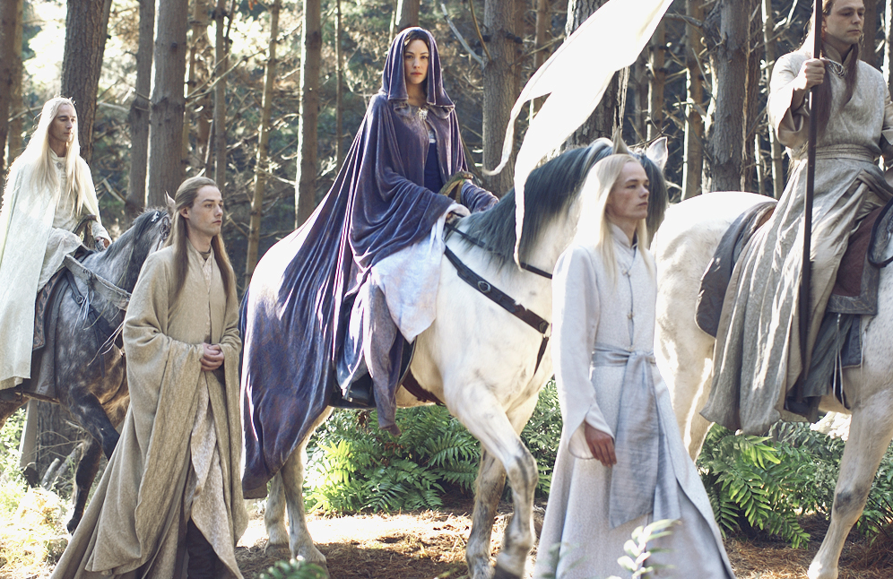
1. Web data is ephemeral
Source:lotr.wikia.com
Format, availability, access requirements can change at any time

Slide 14
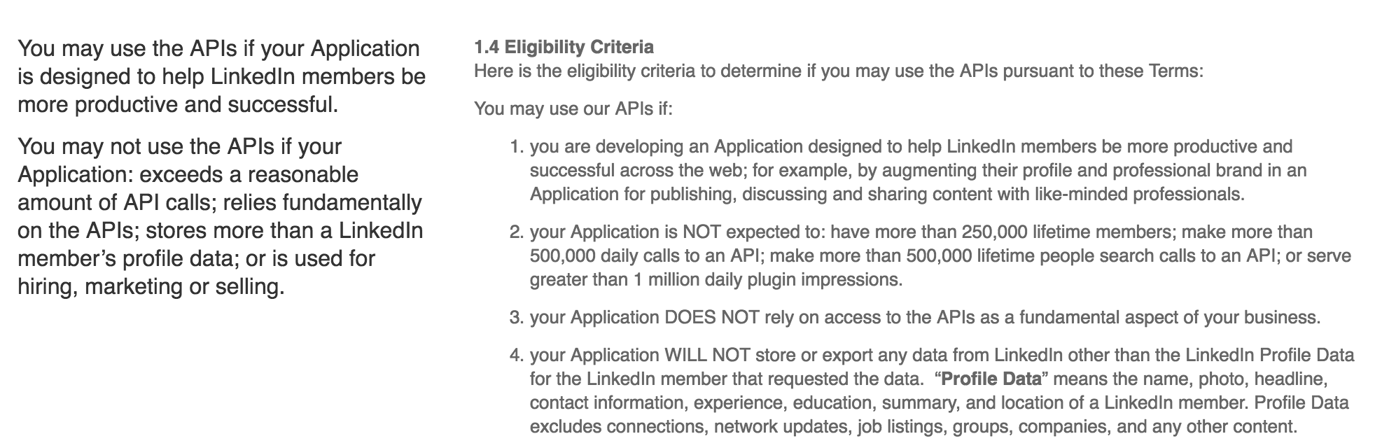
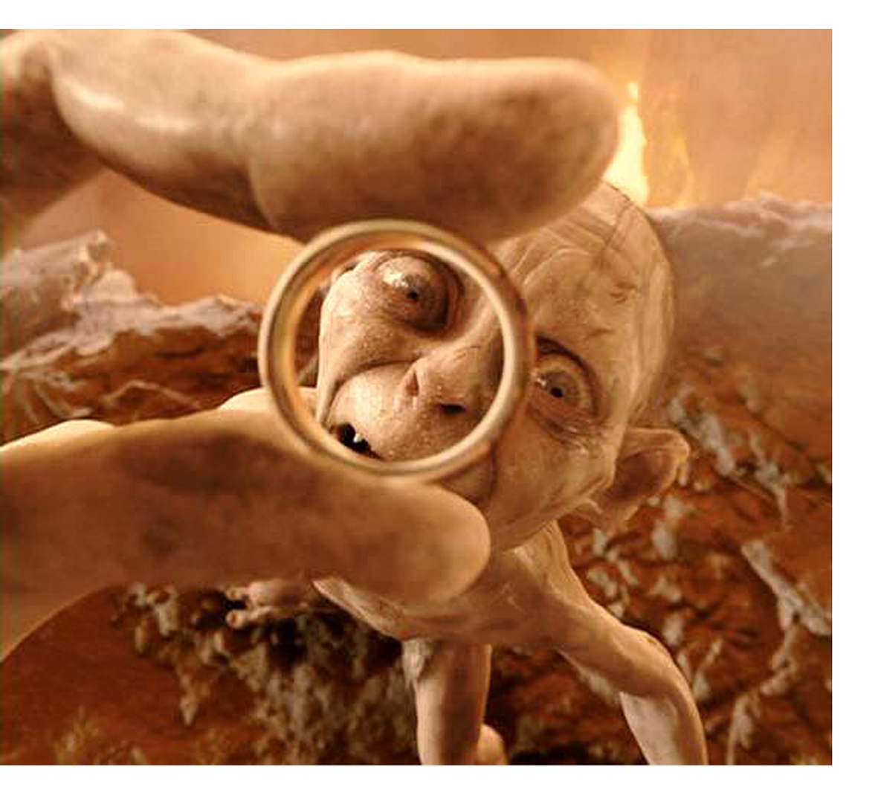
2. Just because you can get the data…
https://developer.linkedin.com/legal/api-terms-of-use
Source:realitysandwich.com

Slide 15
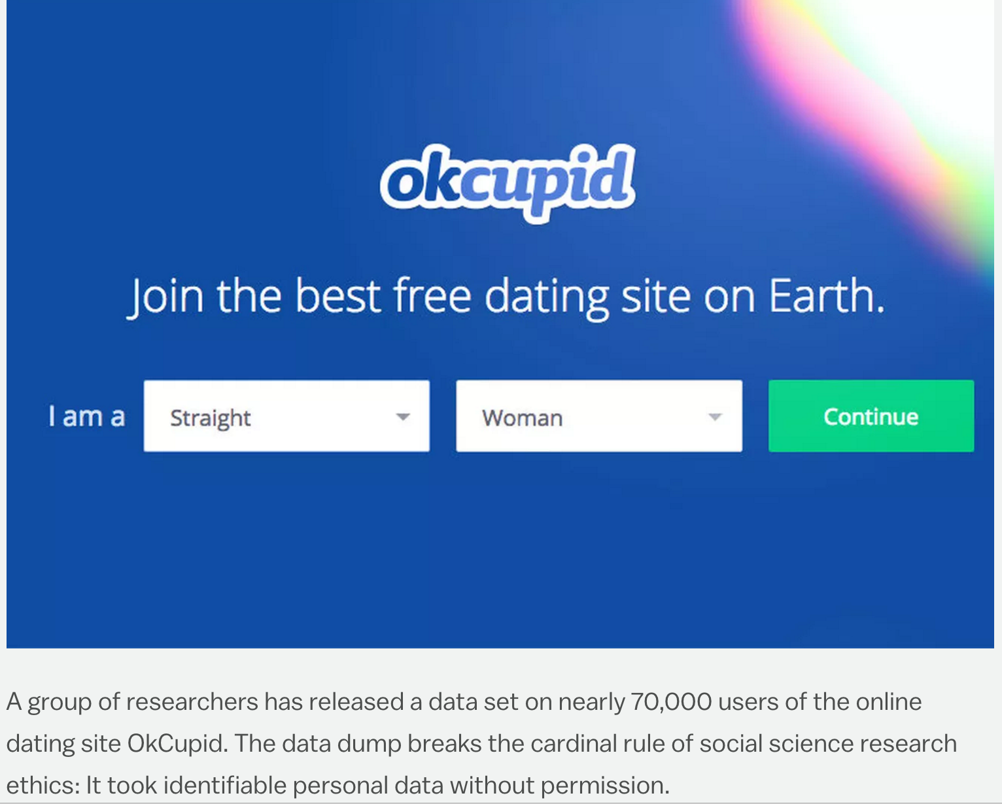

… doesn’t mean you can use it
http://www.vox.com/2016/5/12/11666116/70000-okcupid-users-data-release
Source:doblu.com

Slide 16
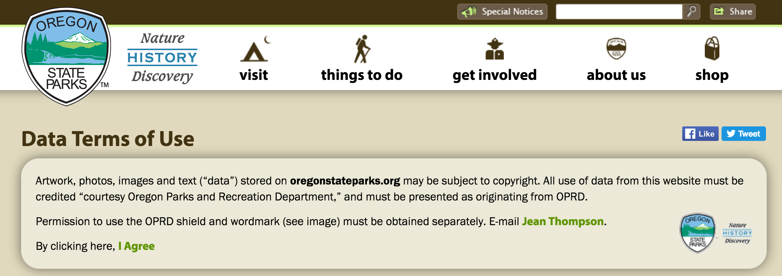
3. Terms of Use - attribute properly
Source:oregonstateparks.org

Slide 17
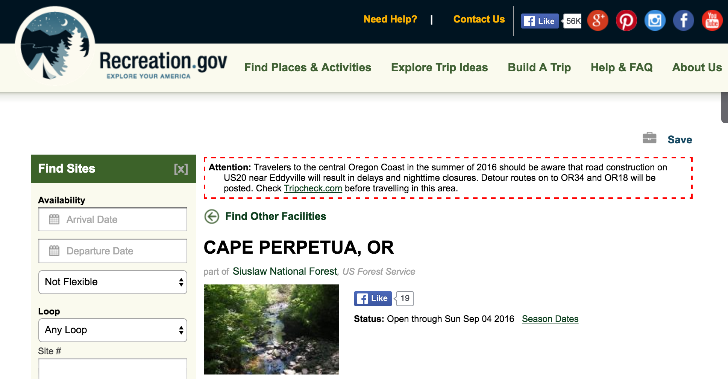

4. Be mindful of the resources of others
Source:lotr.wikia.com

Slide 18
5. Web (any) data is wrong
USFS data for region 6, Oregon and Washington State, has 80% accuracy for latitude and longitude points.
Ex. Driving directions to campgrounds (find a borked example)
Campground usage is light at Lost Lake

Slide 19
Section 1 Summary
Data you gather from the web may not be there tomorrow.
Attribute correctly.
Abuse of resources may result in blacklisting, banning, etc.
Data is wrong. Proceed accordingly!

Slide 20
Agenda
Section 1: Web data best practices
Section 2: Gathering data from the web
15min Break
Lab 2: RIDB API, Scraping USNF pages, recreation.gov form navigation
15min Break
Section 3: Data organization and database design lite
Lab 3: Merging data from Lab 2
Section 4: Pipelining
Lab 4: The One Pipeline

Slide 21
Section 2 – Data gathering and organization
Review: tidy data principles
Each variable is a column
Each observation is a row
Each type of observational unit is a table
Source: Wickham 2014 http://www.jstatsoft.org/v59/i10/paper
Observation: campground
Variables: lat/long, name, website, etc
Observational unit: RIDB, USFS, recreation.gov

Slide 22
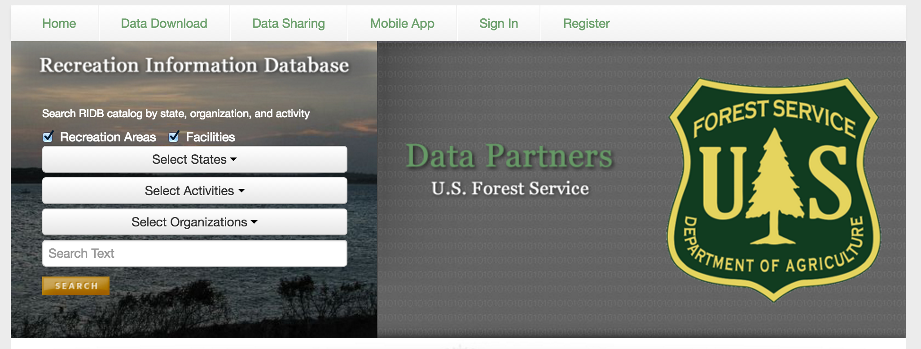
RIDB API
ridb.recreation.gov

Slide 23
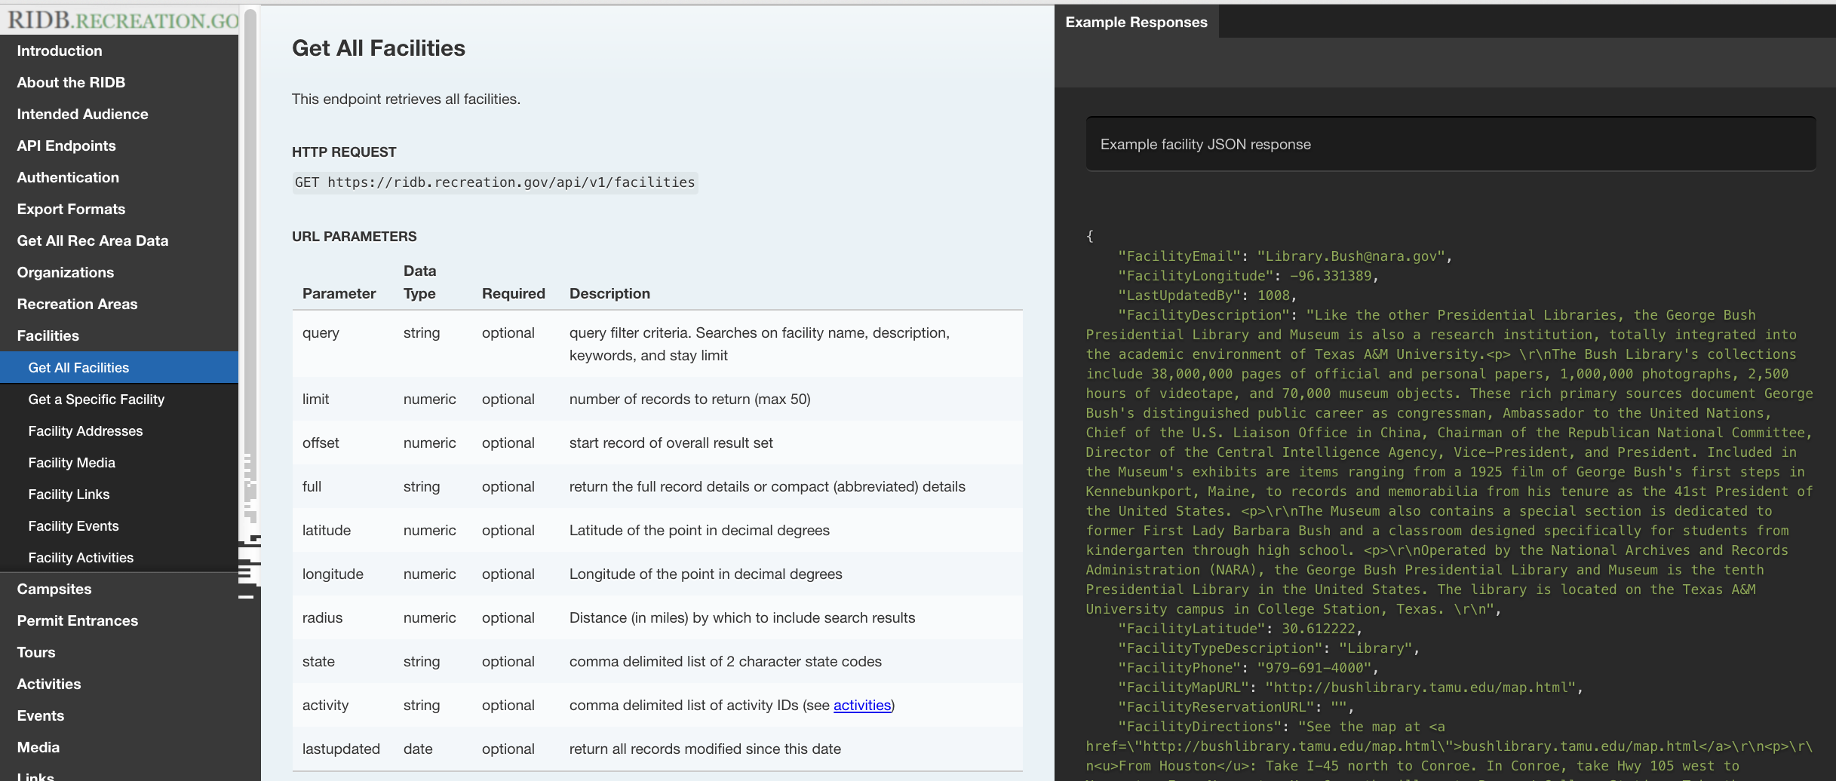
RIDB API Documentation
http://usda.github.io/RIDB

Slide 24
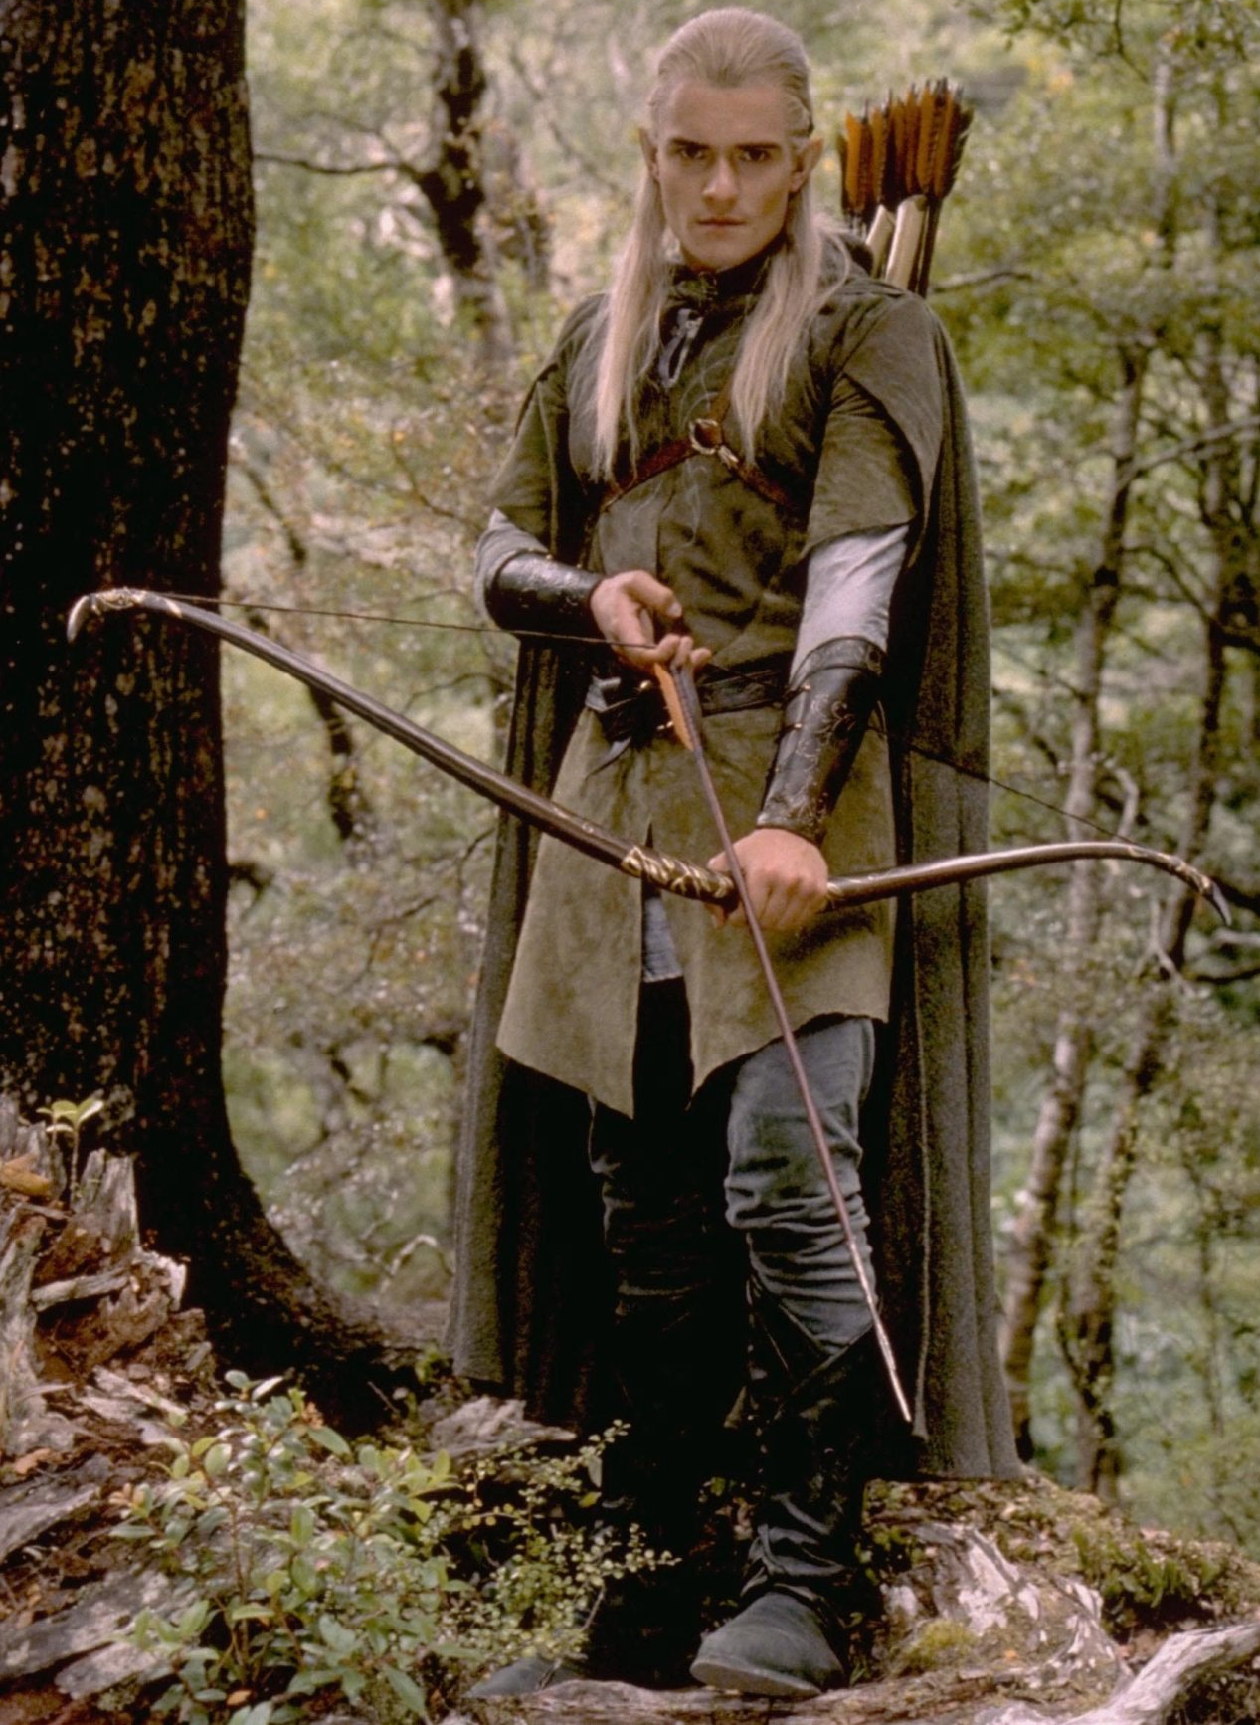
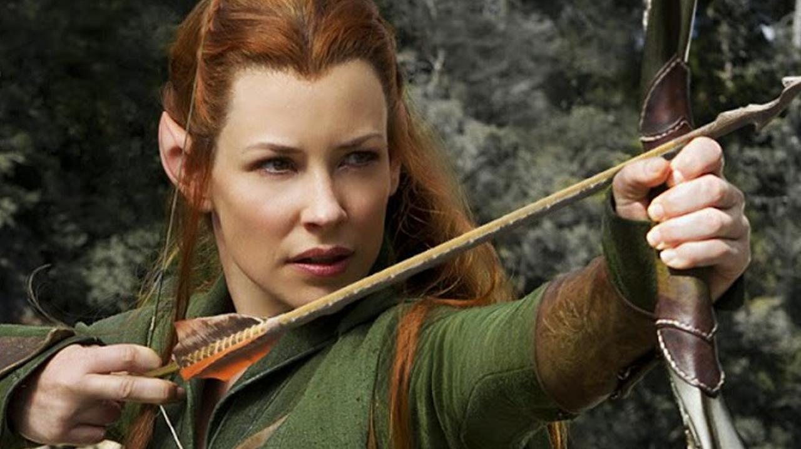
RIDB data notes
Only has campgrounds that can be reserved – no first come, first serve
Missing reservation URLs
Lat / Longs not guaranteed to be accurate

Slide 25
To the Lab!

Slide 26
Lab 1 & 2 summary
Connect to source
Data object
Extract data
Clean / format data
Merge
Store
Analyze
Storage object

Slide 27
RIDB object: one to many
Camping
Hiking
Water Sports
Connect to source
Connect to source
Connect to source
Extract data
Extract data
Extract data
Clean / format data
Clean / format data
Clean / format data
Store
Store
Store

Slide 28
Object Diagram
Storage
Data
MysqlStorage
RidbData
CsvStorage

Slide 29

USFS Website scraping
Selenium
BeautifulSoup

Slide 30
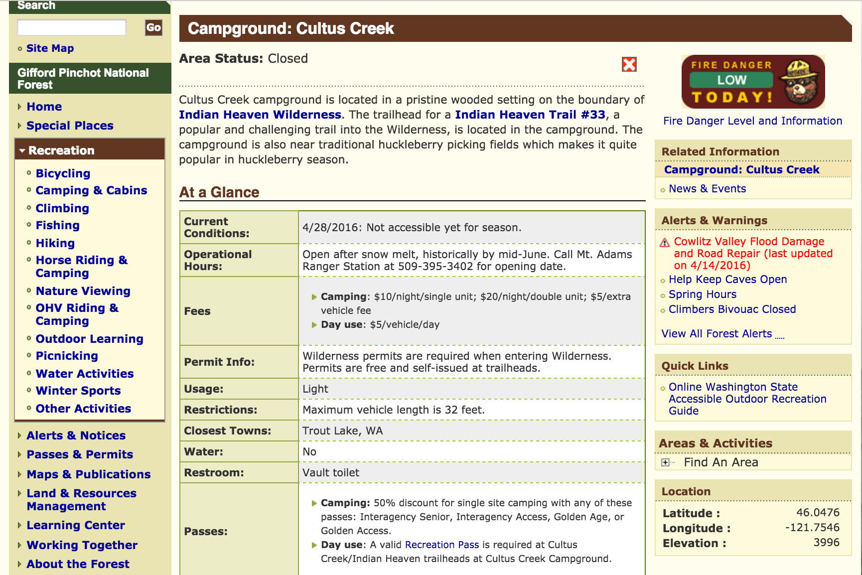

Slide 31
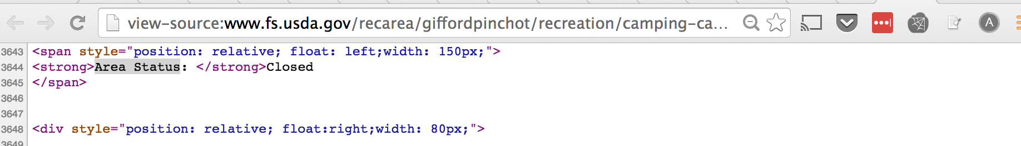
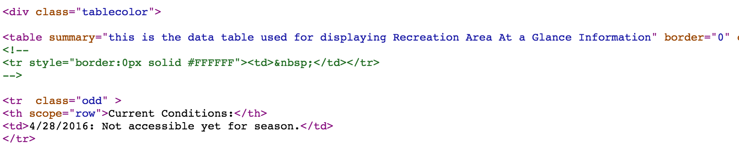

Slide 32
USFS Data
No API
Links are discovered through scraping (already done)
Pages are fairly uniform!

